Slide 1
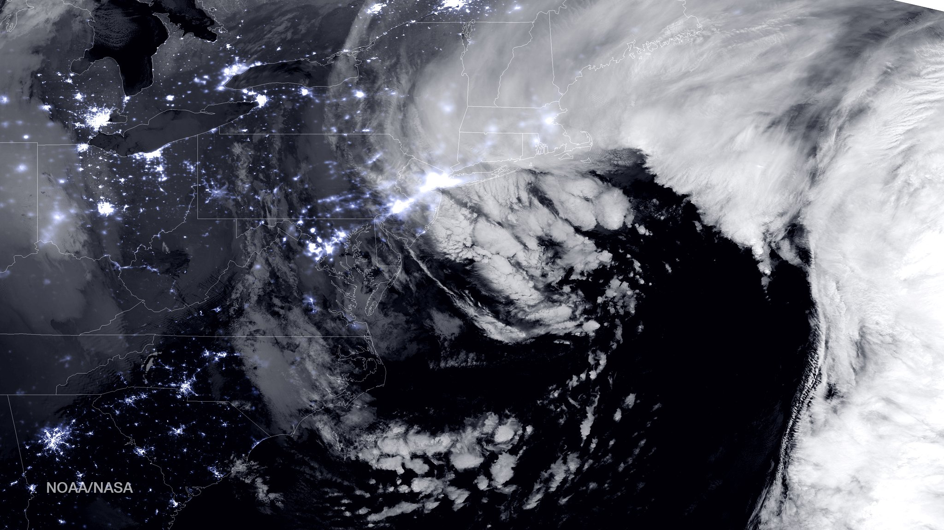
Using Model Climatology to Develop a Confidence Metric
Taylor Mandelbaum, School of Marine and Atmospheric Sciences, Stony Brook, NY
Brian Colle, School of Marine and Atmospheric Sciences, Stony Brook, NY
Trevor Alcott, Earth Systems Research Laboratory, Boulder, CO
* This work is supported by NOAA-CSTAR

Slide 2
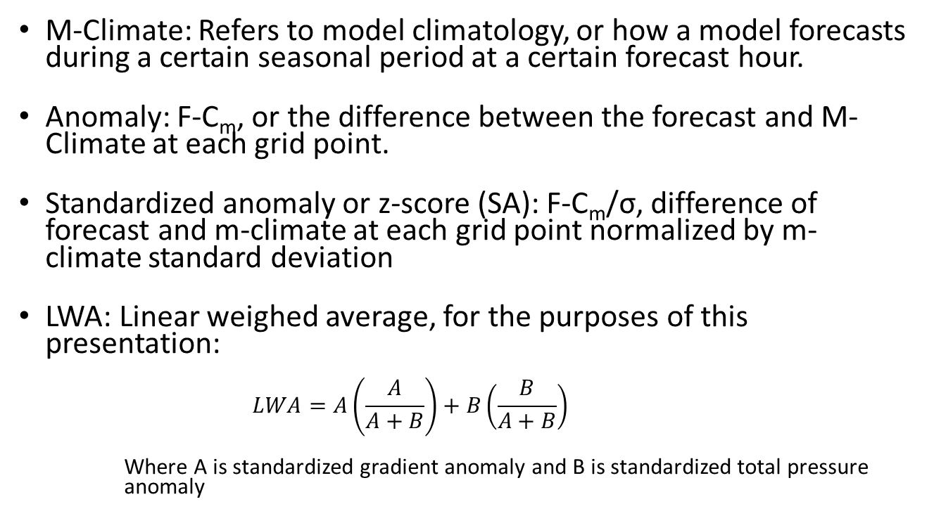
Terminology
M-Climate: Refers to model climatology, or how a model forecasts during a certain seasonal period at a certain forecast hour.
Anomaly: F-C_{m}, or the difference between the forecast and M-Climate at each grid point.
Standardized anomaly or z-score (SA): F-C_{m}/σ, difference of forecast and m-climate at each grid point normalized by m-climate standard deviation
LWA: Linear weighed average, for the purposes of this presentation:
$$LWA=A\left(\frac{A}{A+B}\right)+B\left(\frac{B}{A+B}\right)$$
Where A is standardized gradient anomaly and B is standardized total pressure anomaly

Slide 3
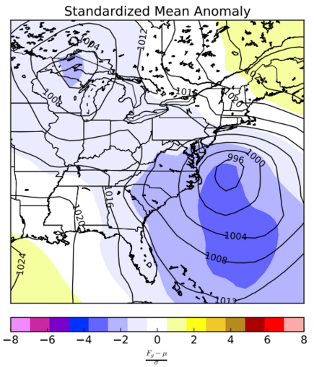
Motivation
Mean anomaly can show how anomalous a forecast is but…
Is the model spread for that forecast greater or less than normal for the SA?
If the spread is less than normal this should translate to greater confidence.
Pictured: SA of 48h GEFS mean forecast (using M-Climate) valid 27 Jan 2015, 0000 UTC

Slide 4
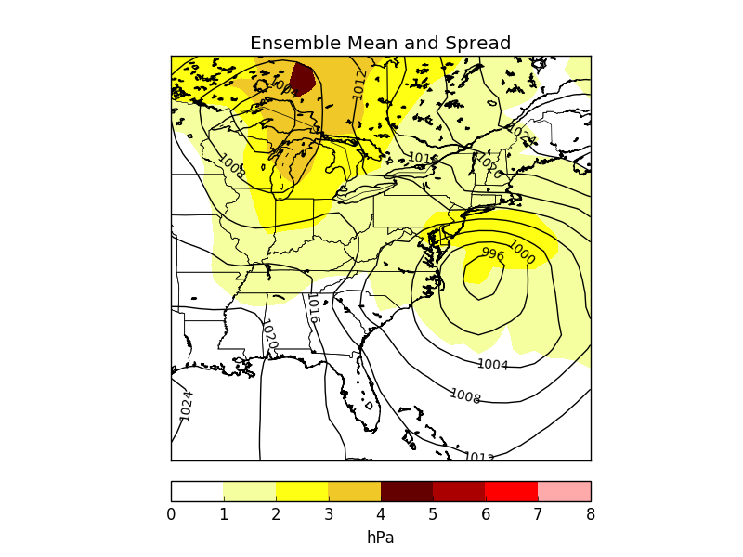
Motivation
This is the conventional way to view spread, calculated relative to the ensemble mean
But, there is no prior knowledge incorporated to understand if this forecast is more or less predictable than other cyclones at this same forecast lead time.
Pictured: 48h GEFS ensemble mean (isobars) and spread (shaded) valid 27 Jan 2015 0000 UTC

Slide 5
Motivational Questions
Can we use the model climate to calculate the climatological spread for more anomalous weather events?
Can one use this climatological spread to determine how anomalous the spread may be for a particular forecast and location?
How can we best communicate these spread anomalies?

Slide 6
Outline
Methodology: How the tool is constructed
Show three cases as examples: One with large spread, another with smaller spread, and a recent case using the operational GEFS
Future work: what can be done to help improve the tool, different variables, how can operational forecasters best utilize it, etc

Slide 7
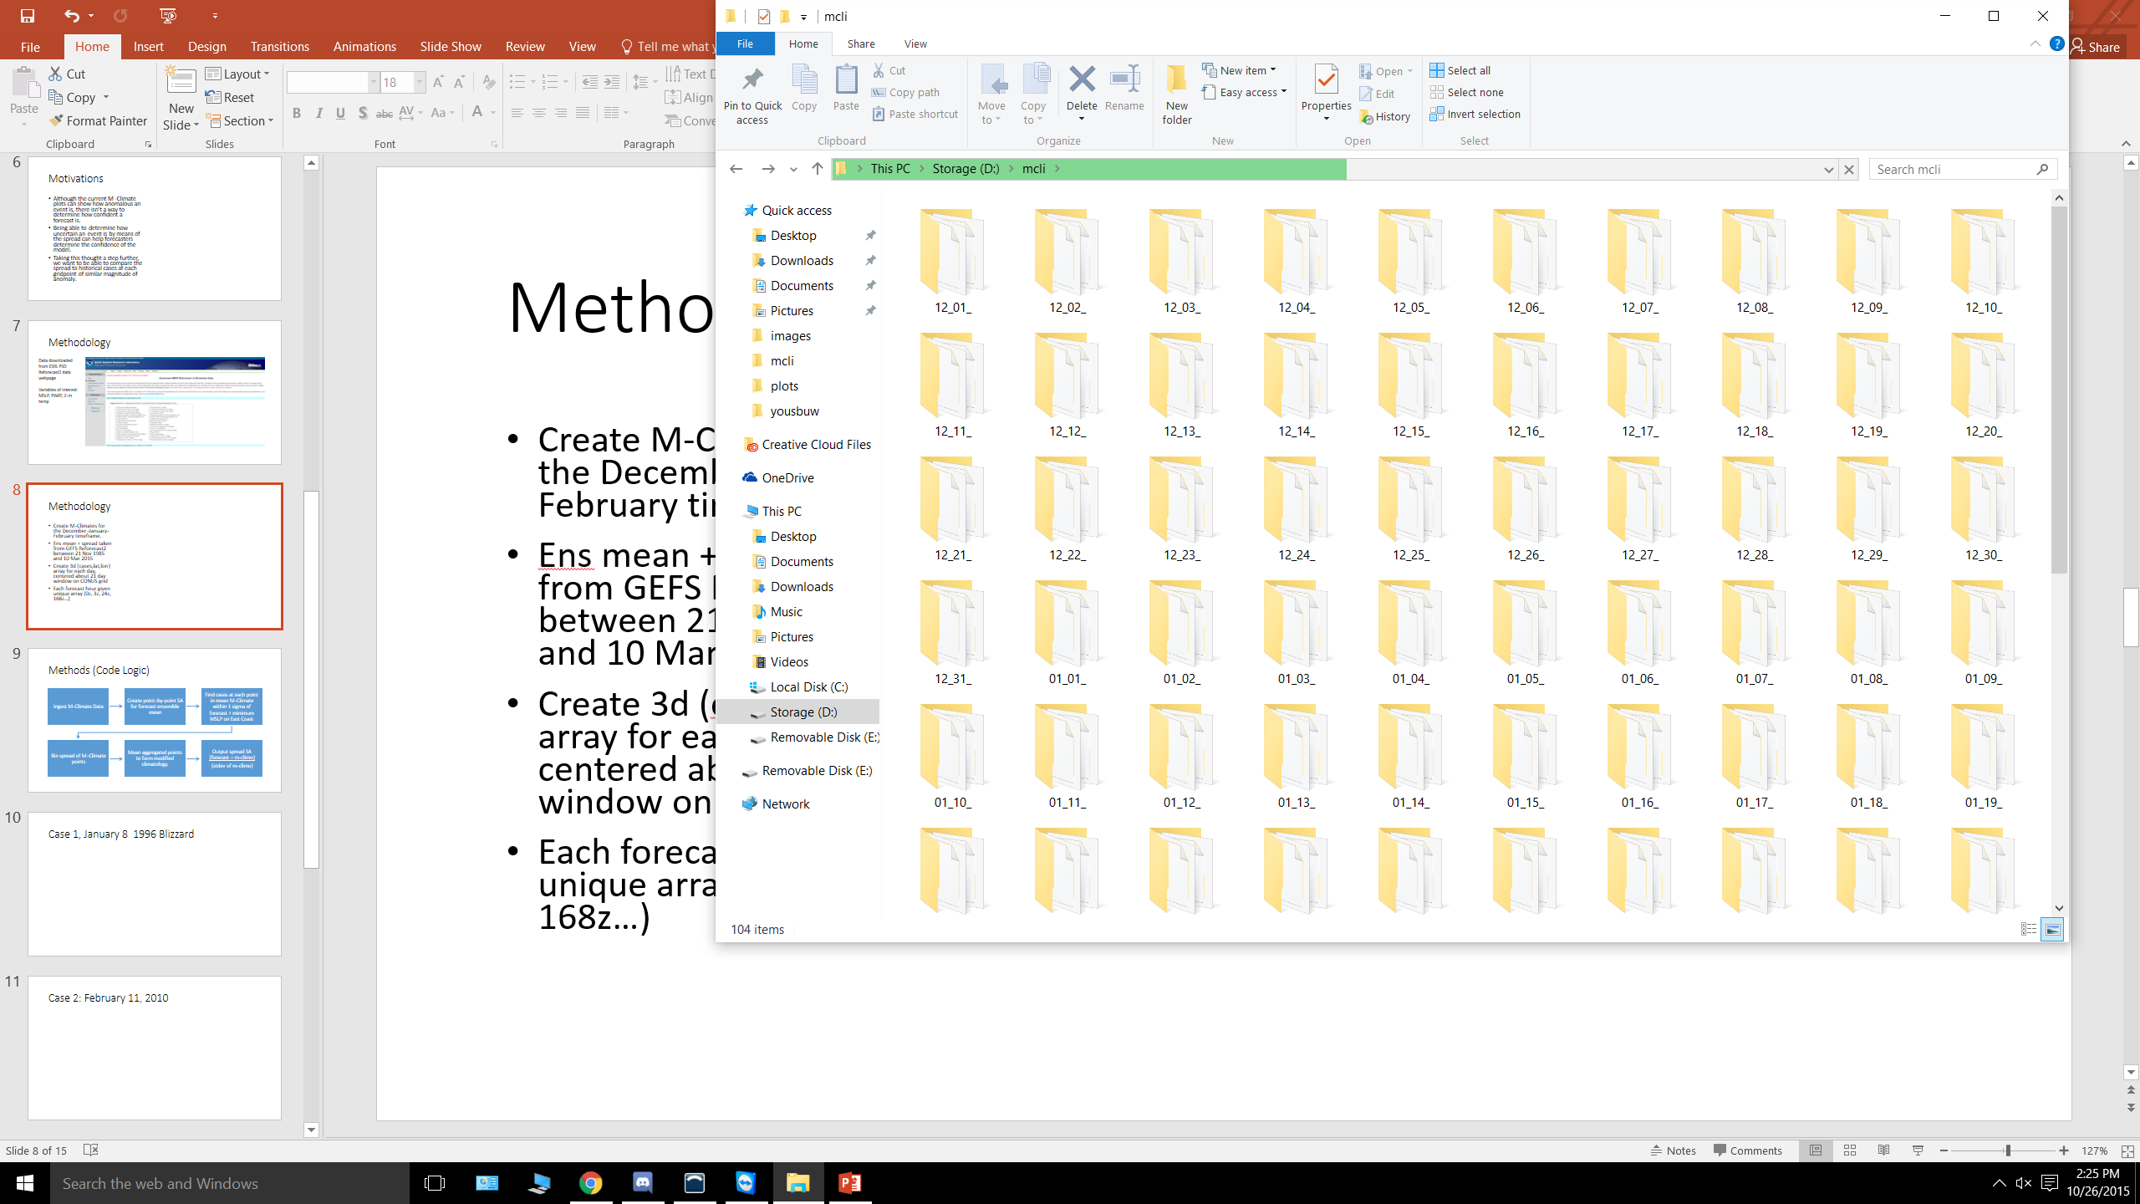
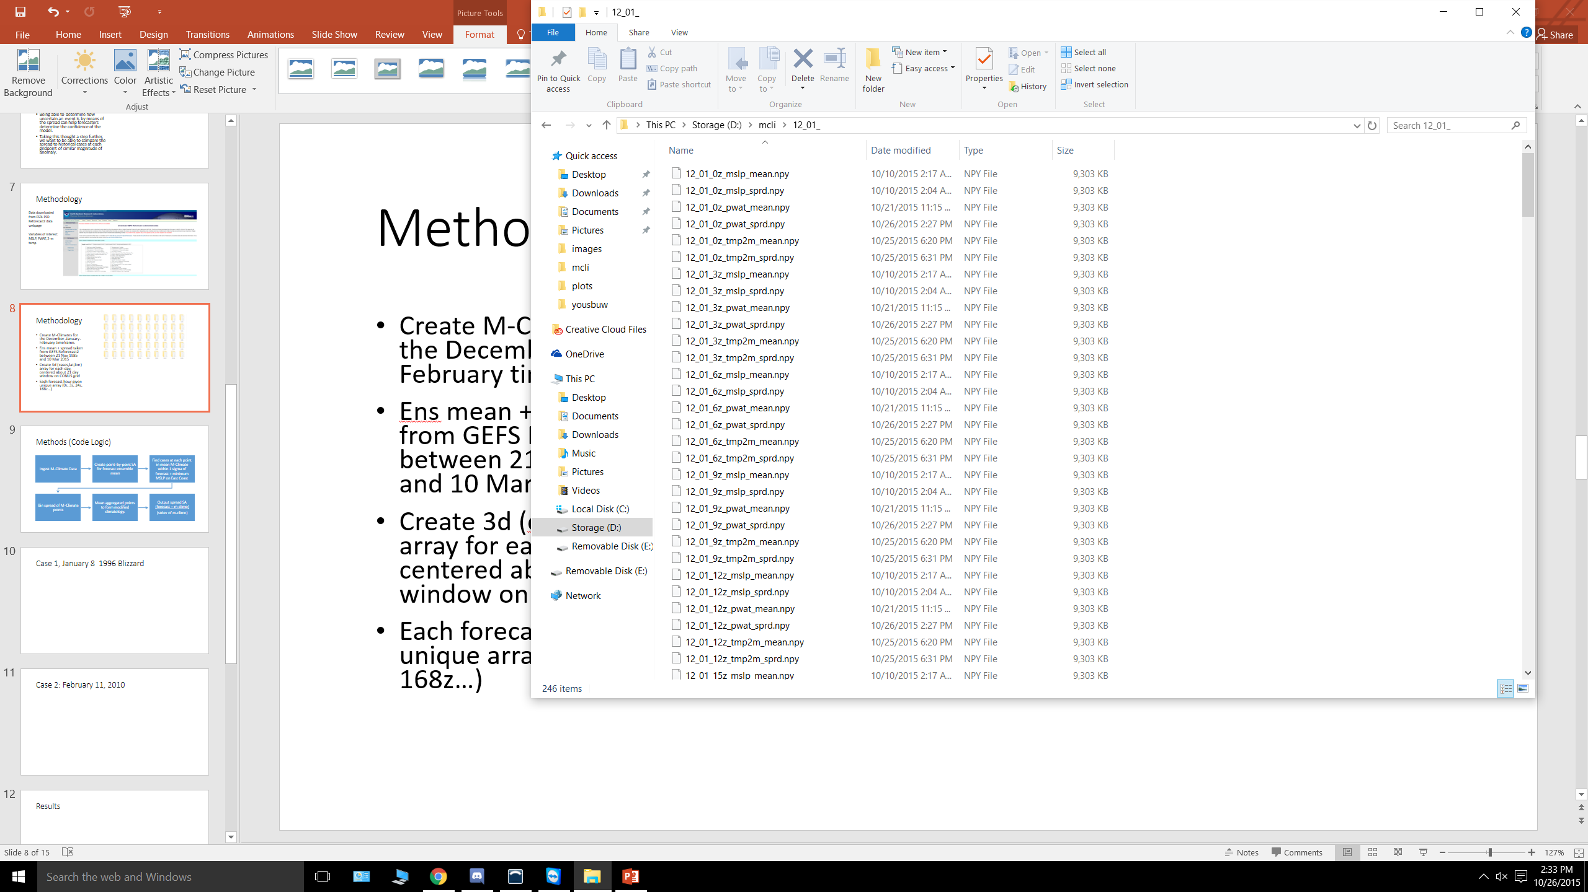
Datasets
GEFS Reforecast2 from ESRL every 6-h from Nov 1985 to March 2015.
Create M-Climates for the winter (December-February) season.
Obtain ens mean + spread taken from GEFS Reforecast2.
Create array for each day, centered about 21 day window on CONUS grid. For 1985-2015, each array is (630,30,63).
Each forecast hour given unique array (0z, 3z, 24z, 168z…).
Use M-Climate to determine spread anomaly in GEFS.

Slide 8
Method to Obtain Standardized Spread Anomaly
M-Climate data loaded into code
Find standardized anomaly for each point of forecast ensemble mean*
Go through mean M-Climate to find similar anomalous points
Take mean of spread cases at each point to form anomaly-based climatology
Output spread standardized anomaly
For each point with valid anomaly, take spread of that point
*Alternatively, can use gradient in place of mean (coming up soon…)

Slide 9
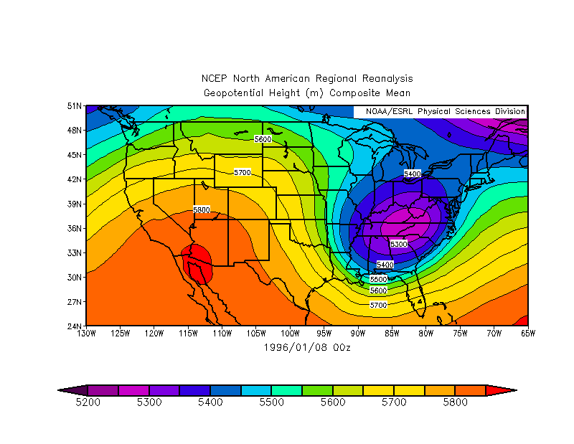
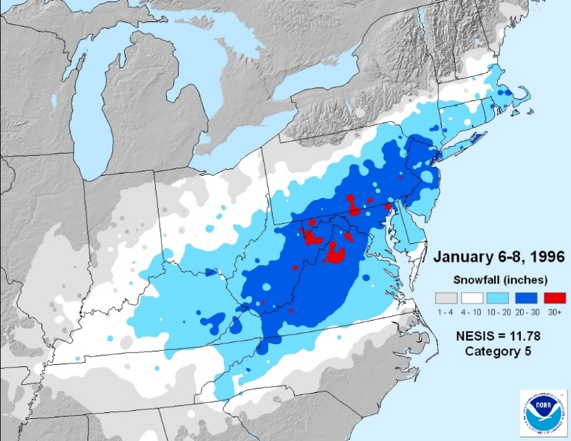
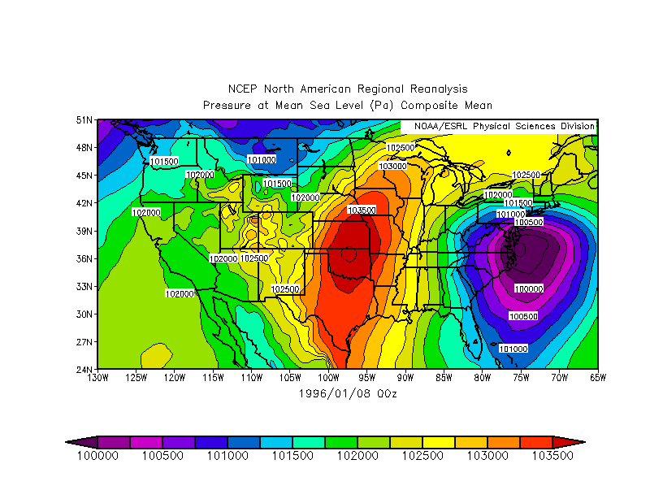
Case 1: 8 January 1996
Taken from ESRL PSD Reanalysis 0.3x0.3 degree dataset
Strong offshore low which developed into a nor’easter – how confident was GEFS relative to storms of similar magnitude?
500mb Hgts
MSLP
From NESIS

Slide 10
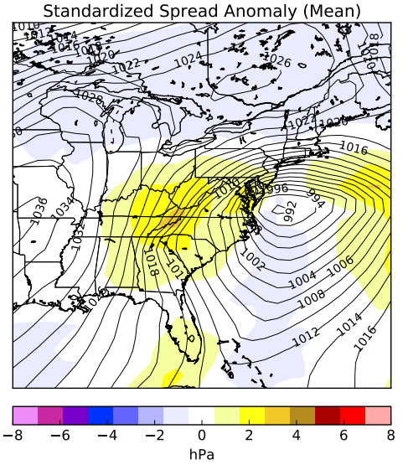
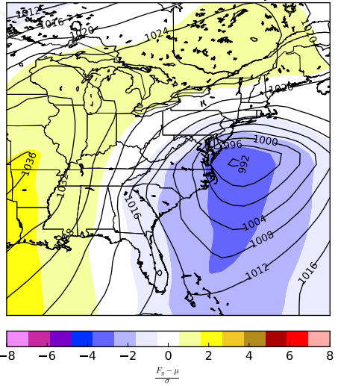
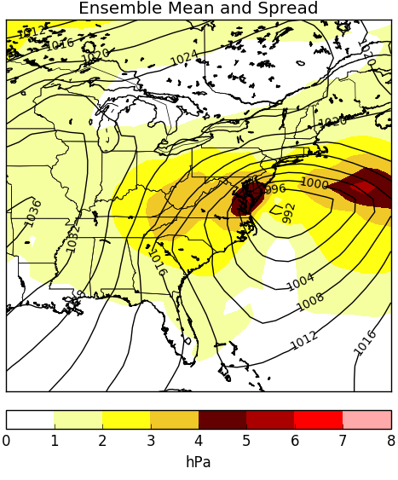
Using Mean Pressure Anomaly
Areas about the center of a low will have high spread due to typical ens reasons (location, speed, strength, etc).
Can create a modified climatology of similar anomalies to compare against.
Pictured: 05 Jan 1996 00z 72h valid 00z 08 Jan 1996 (Reforecast2)
Standardized MSLP Anomaly
Standardized Spread Anomaly (MSLP)

Slide 11
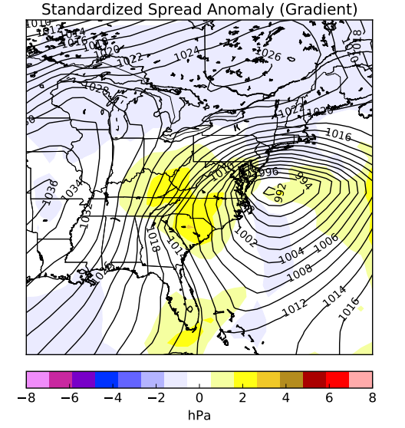
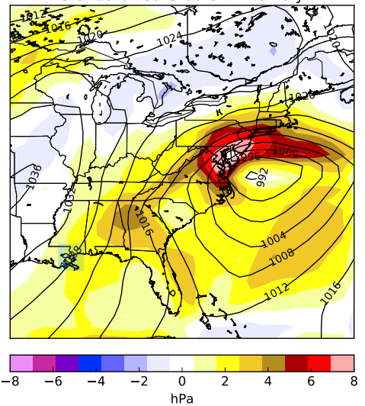
Using Gradient Anomaly
When using mean to determine anomaly, areas in a tight gradient will have higher spread than other cases.
To account for this, testing a gradient based anomaly by taking the magnitude of the gradient at each point
Pictured: 05 Jan 1996 00z 72h valid 00z 08 Jan 1996 (Reforecast2)
Standardized Gradient Anomaly
Standardized Spread Anomaly (Gradient)

Slide 12
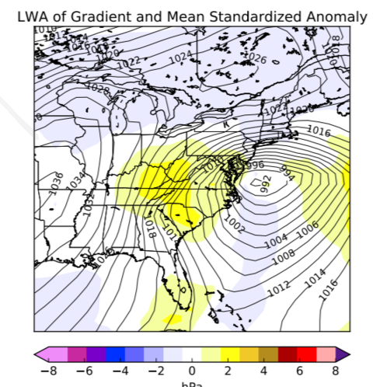
Using a Linear Weighted Average
We can combine the strengths of both standardized spread anomalies (MSLP and gradient) by using a linear weighted average.

Slide 13
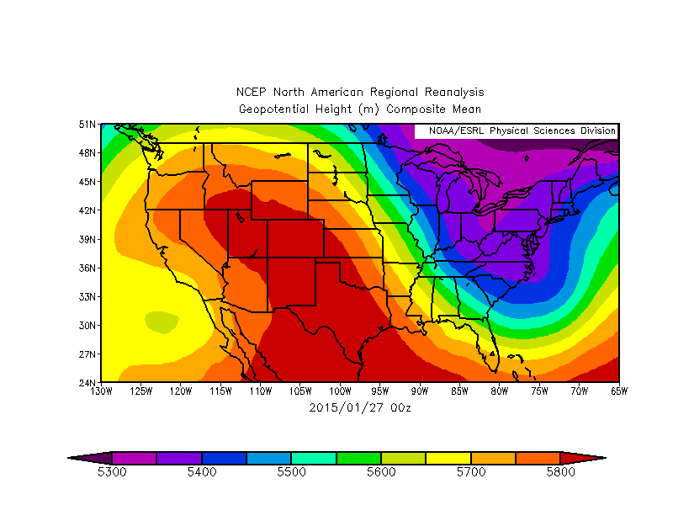
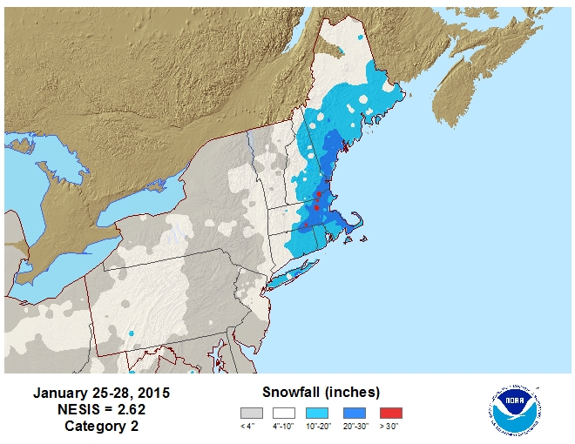
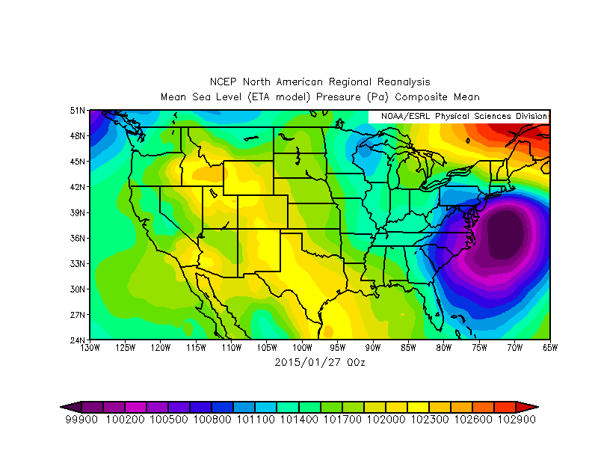
Case 2: 27 Jan 2015
Taken from ESRL PSD Reanalysis 0.3x0.3 degree dataset
500mb Hgts
MSLP
From NESIS

Slide 14
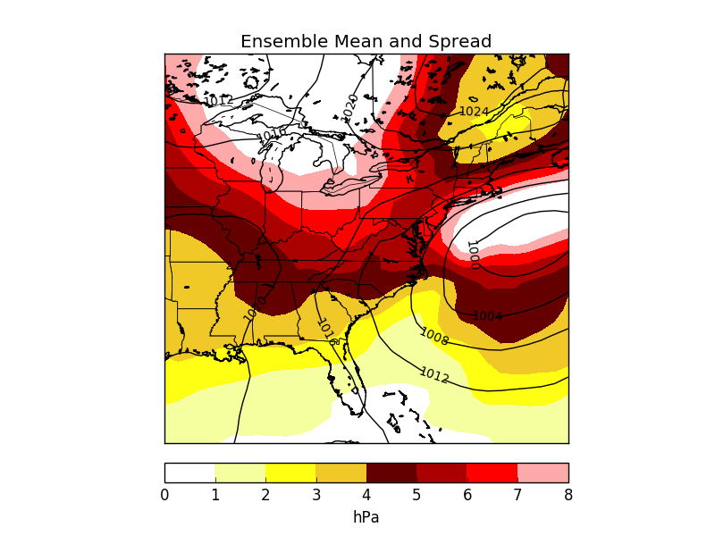
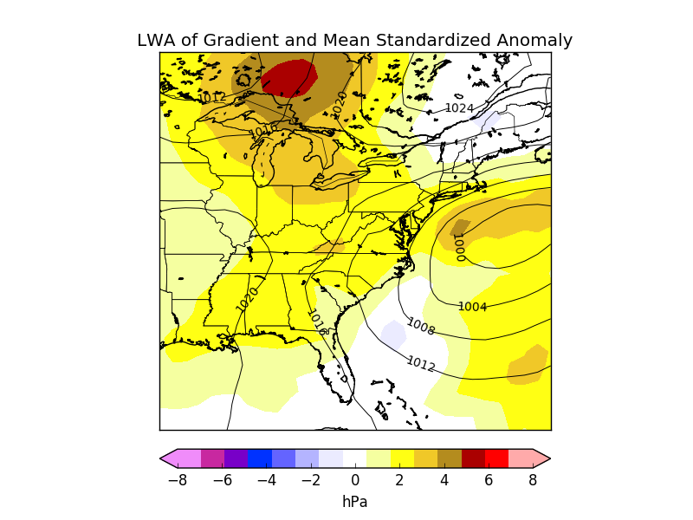
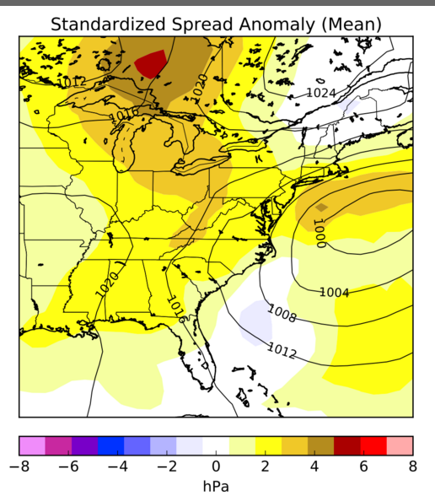
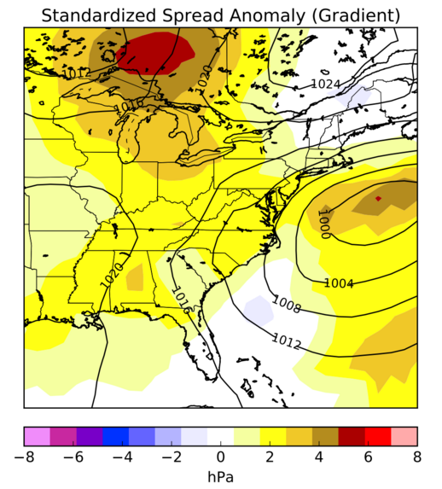
96h Forecast Valid 0000 UTC 27 Jan 2015 Standardized spread results more than climatology

Slide 15
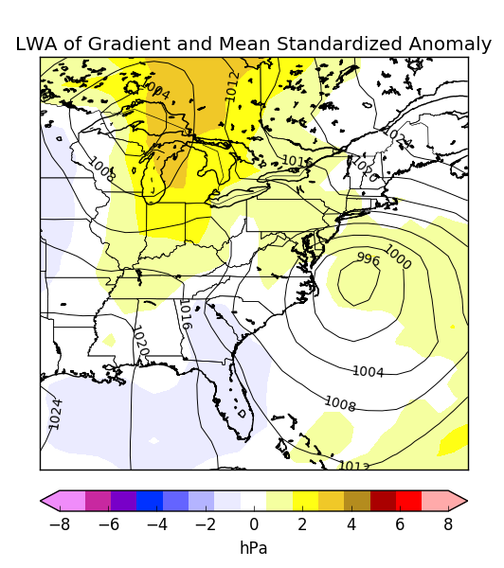
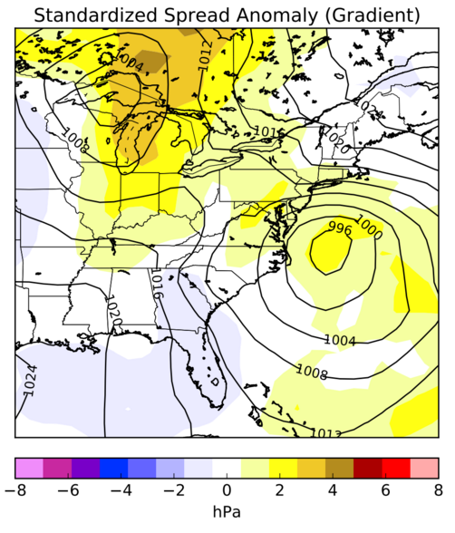
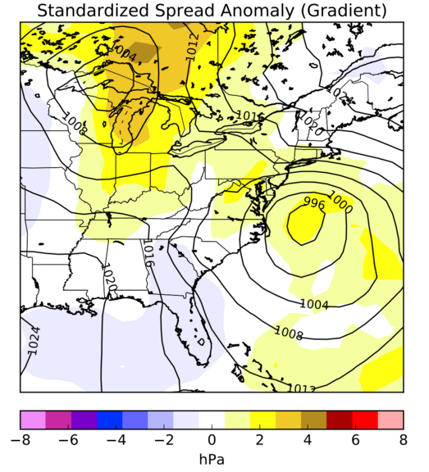
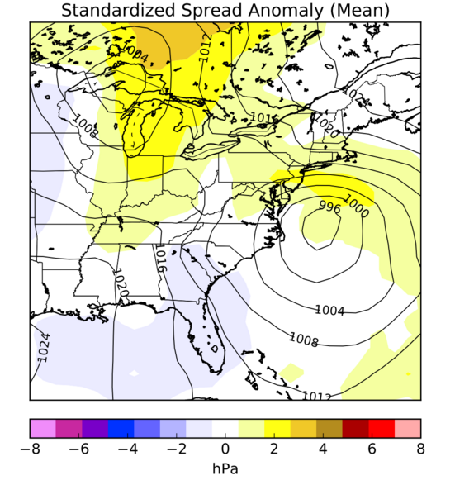
48h Forecast Valid 0000 UTC 27 Jan 2015 Standardized spread results more than climatology

Slide 16
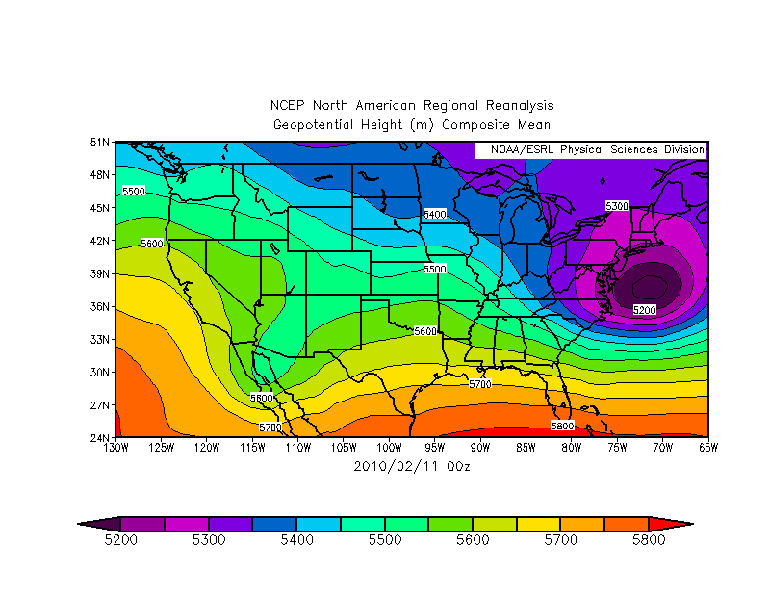
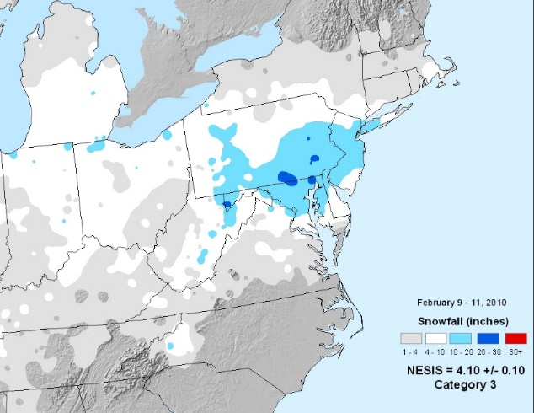
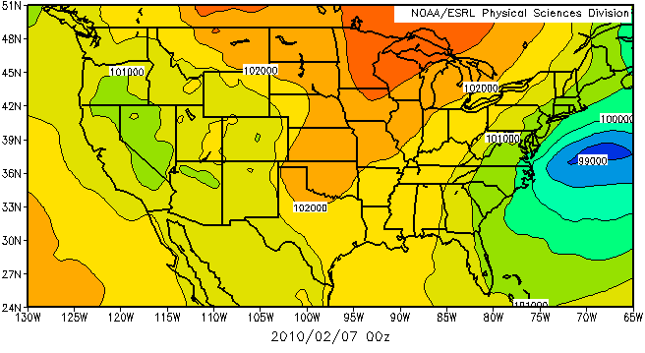
Case 3: 11 February 2010
Taken from ESRL PSD Reanalysis 0.3x0.3 degree dataset
500mb Hgts
MSLP
From NESIS
MSLP

Slide 17
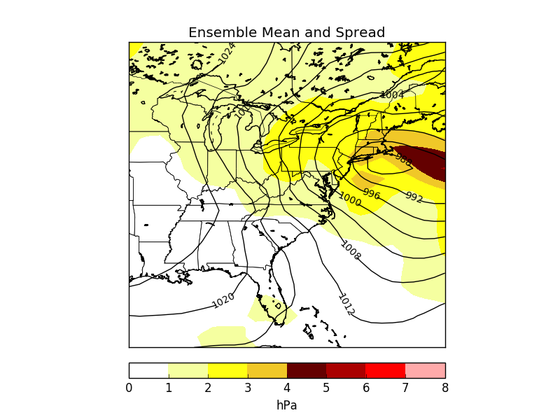
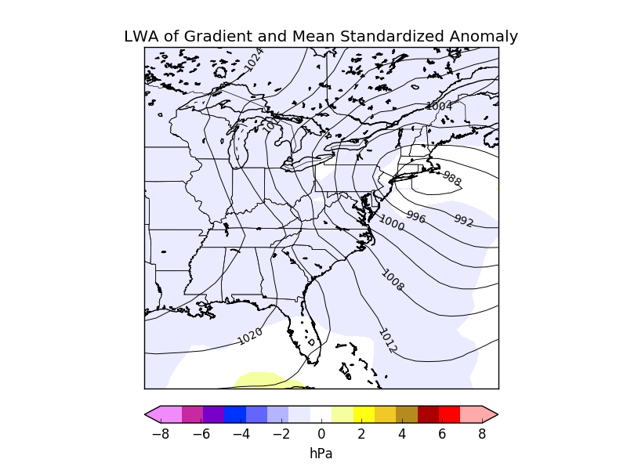
96h Forecast Valid 0000 UTC 11 Feb 2010 Standardized spread results slightly lower than climatology

Slide 18
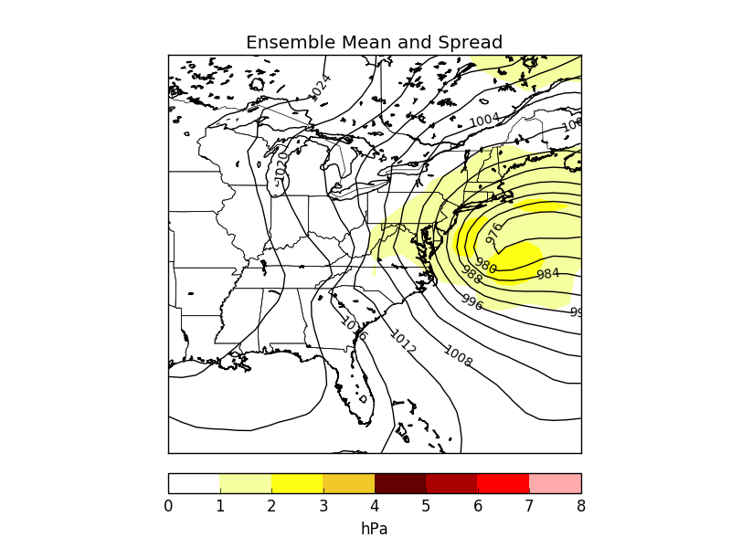
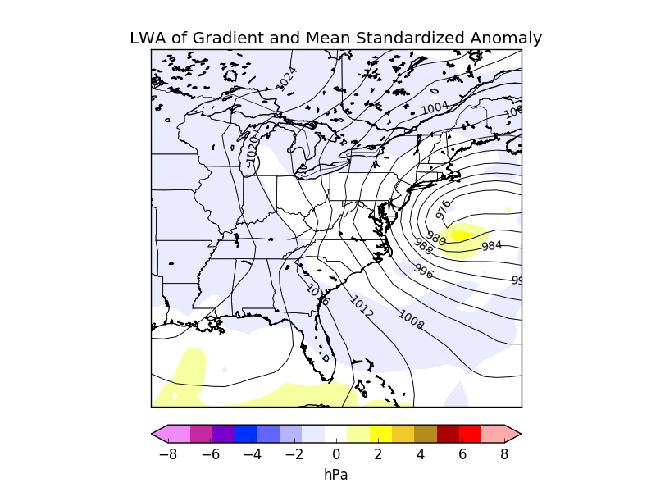
48h Forecast Valid 0000 UTC 11 Feb 2010 Standardized spread results slightly lower than climatology

Slide 19
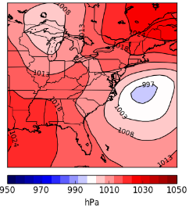
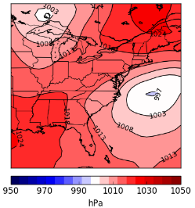
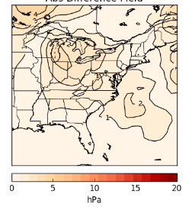
Using the Tool With the Current GEFS
Reforecast consists of 10 members – real time GEFS contains 20 members + control.
Slight differences exist but aren’t conflicting
Reforecast MSLP, 0000 UTC 24 Jan 2015 72h Valid 0000 UTC 27 Jan 2015
Retrospective GEFS MSLP, 0000 UTC 24 Jan 2015 72h Valid 0000 UTC 27 Jan 2015
Absolute Difference, 0000 UTC 24 Jan 2015 72h Valid 0000 UTC 27 Jan 2015

Slide 20
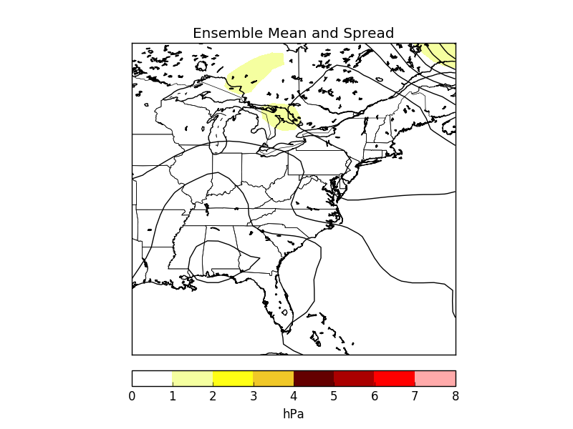
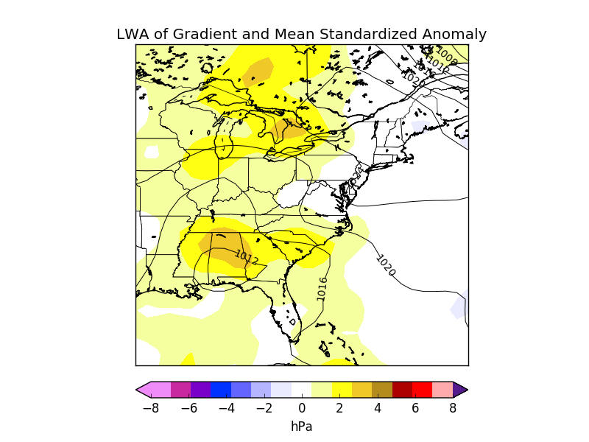
Real Time GEFS Example, 3 Mar 2016 1200 UTC 12hr Forecast Valid 0000 UTC 4 Mar 2016

Slide 21
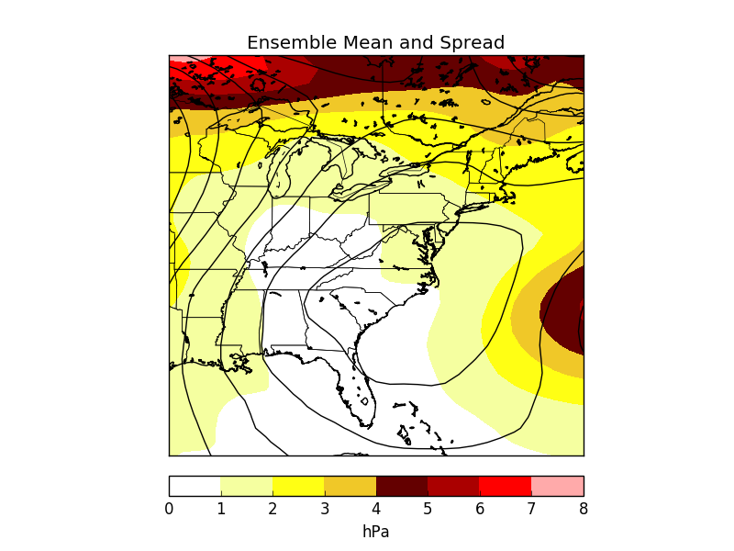
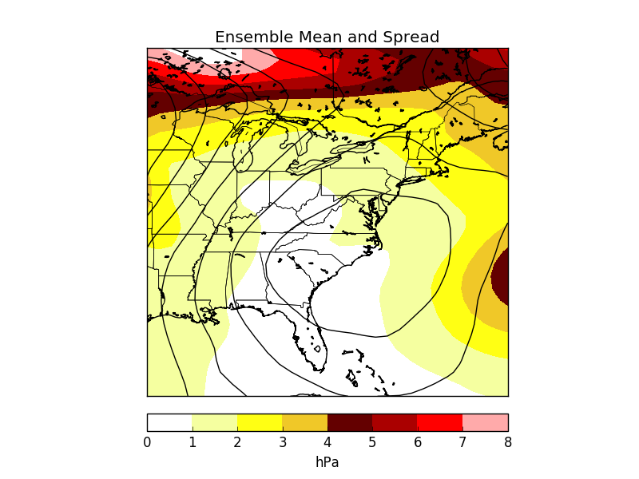
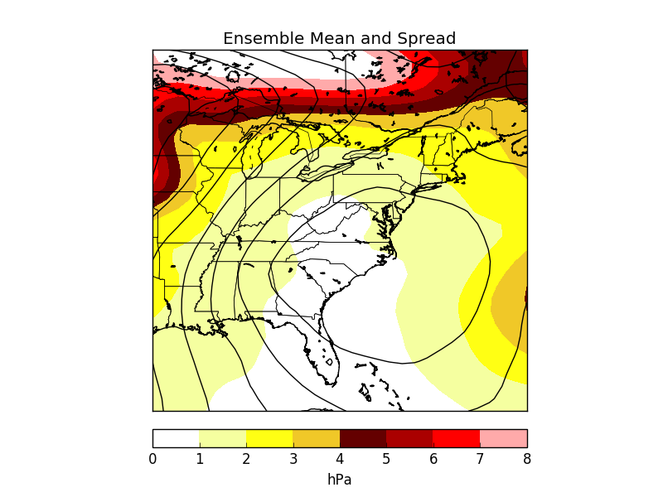
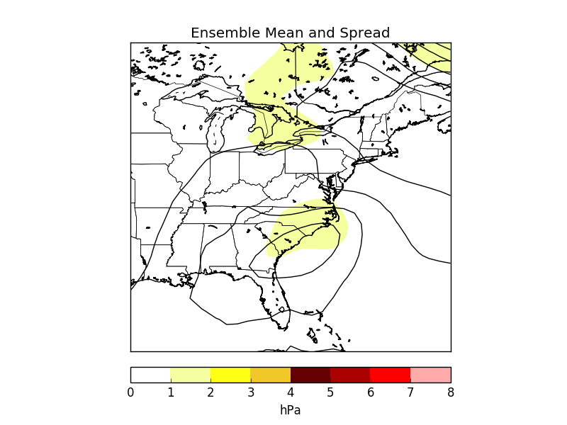
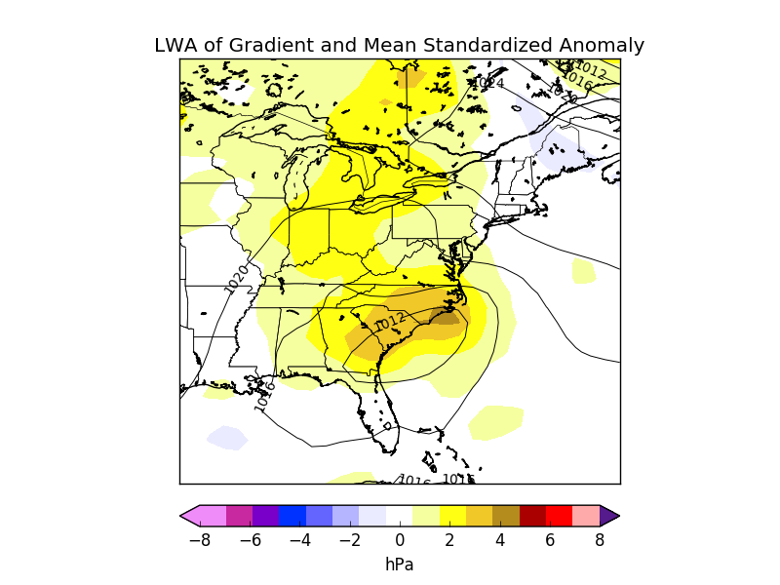
Real Time GEFS Example, 3 Mar 2016 1200 UTC 18hr Forecast Valid 0600 UTC 4 Mar 2016

Slide 22
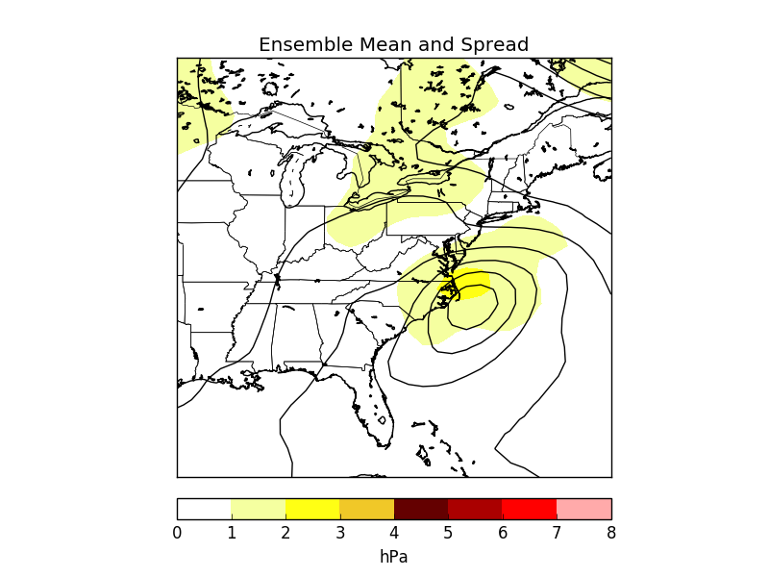
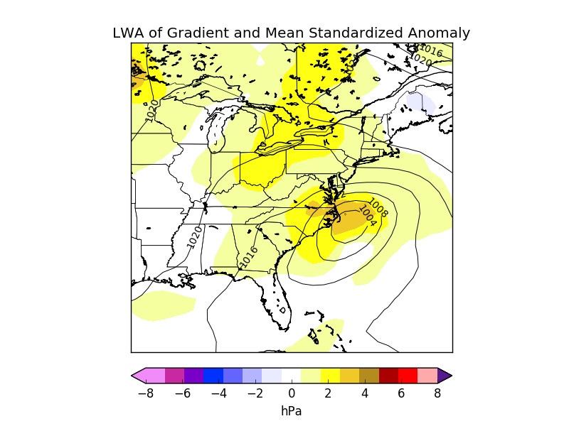
Real Time GEFS Example, 3 Mar 2016 1200 UTC 24hr Forecast Valid 1200 UTC 4 Mar 2016

Slide 23
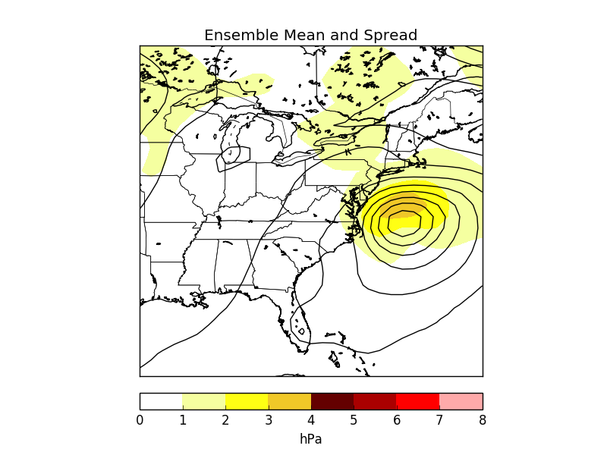
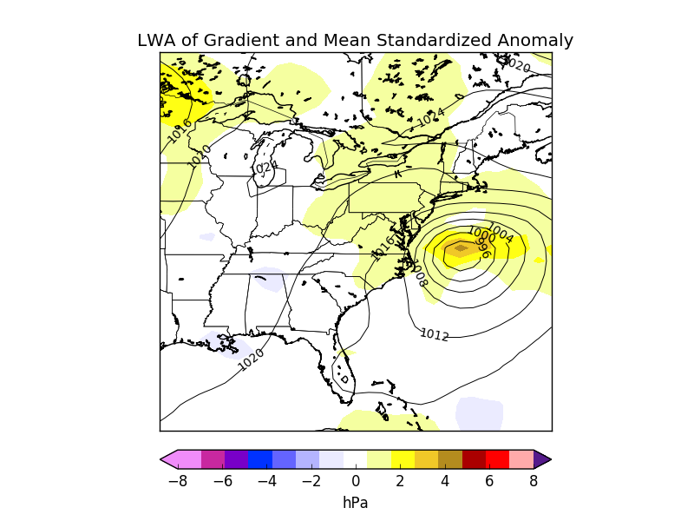
Real Time GEFS Example, 3 Mar 2016 1200 UTC 30hr Forecast Valid 1800 UTC 4 Mar 2016

Slide 24
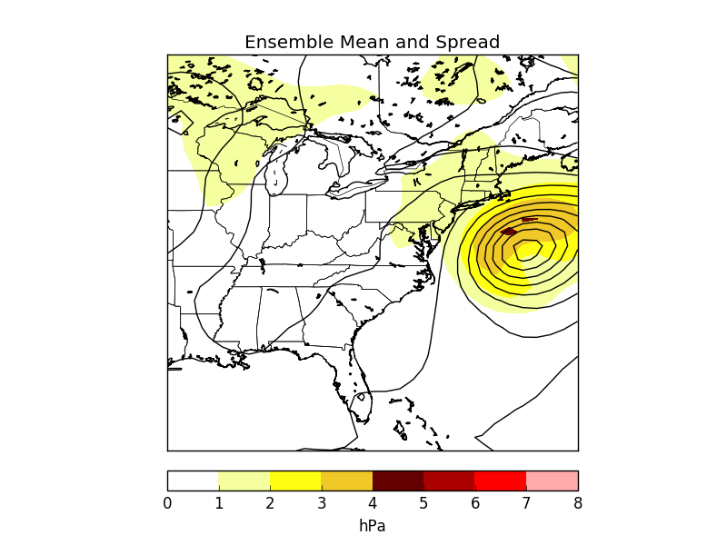
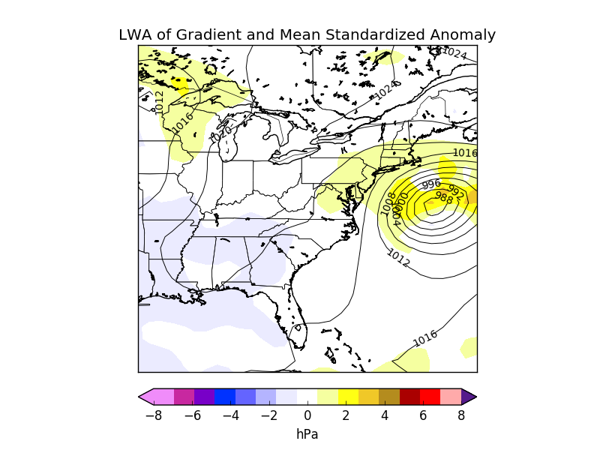
Real Time GEFS Example, 3 Mar 2016 1200 UTC 36hr Forecast Valid 0000 UTC 5 Mar 2016

Slide 25
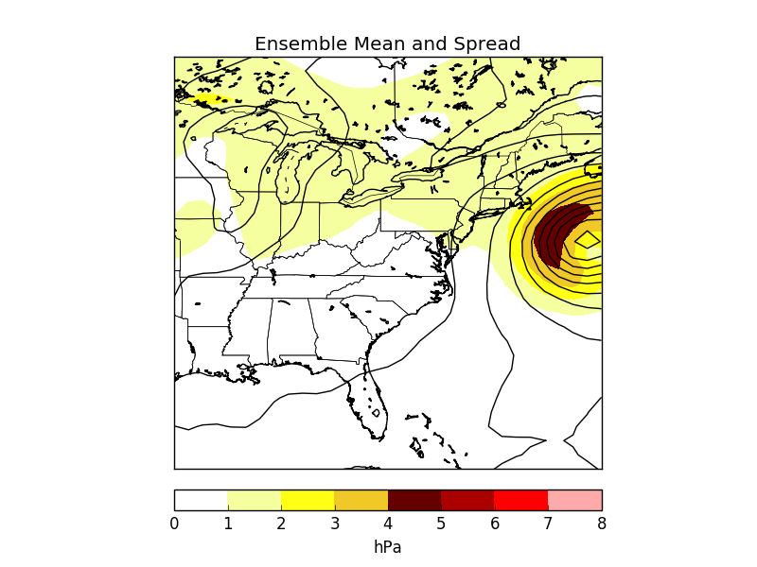

Real Time GEFS Example, 3 Mar 2016 1200 UTC 42hr Forecast Valid 0600 UTC 5 Mar 2016

Slide 26


Real Time GEFS Example, 3 Mar 2016 1200 UTC 48hr Forecast Valid 1200 UTC 5 Mar 2016

Slide 27


Real Time GEFS Example, 3 Mar 2016 1200 UTC 54hr Forecast Valid 1800 UTC 5 Mar 2016

Slide 28


Real Time GEFS Example, 3 Mar 2016 1200 UTC 60hr Forecast Valid 0000 UTC 6 Mar 2016

Slide 29


Real Time GEFS Example, 3 Mar 2016 1200 UTC 66hr Forecast Valid 0600 UTC 6 Mar 2016

Slide 30


Real Time GEFS Example, 3 Mar 2016 1200 UTC 72hr Forecast Valid 1200 UTC 6 Mar 2016

Slide 31


Real Time GEFS Example, 3 Mar 2016 1200 UTC 78hr Forecast Valid 1800 UTC 6 Mar 2016

Slide 32


Real Time GEFS Example, 3 Mar 2016 1200 UTC 84hr Forecast Valid 0000 UTC 7 Mar 2016

Slide 33


Real Time GEFS Example, 3 Mar 2016 1200 UTC 90hr Forecast Valid 0600 UTC 7 Mar 2016

Slide 34


Real Time GEFS Example, 3 Mar 2016 1200 UTC 96hr Forecast Valid 1200 UTC 7 Mar 2016

Slide 35


Real Time GEFS Example, 3 Mar 2016 1200 UTC 102hr Forecast Valid 1800 UTC 7 Mar 2016

Slide 36

Real Time GEFS Example, 3 Mar 2016 1200 UTC 108hr Forecast Valid 0000 UTC 8 Mar 2016

Slide 37

Real Time GEFS Example, 3 Mar 2016 1200 UTC 114hr Forecast Valid 0600 UTC 8 Mar 2016

Slide 38

Real Time GEFS Example, 3 Mar 2016 1200 UTC 120hr Forecast Valid 1200 UTC 8 Mar 2016

Slide 39
Conclusions
The tool shows promise towards being able to determine large spread vs small spread days relative to the M-Climate of similar anomalies.
Case studies illustrate that there can be relatively large differences in spread from storm to storm along the U.S. East Coast.
There is a benefit to combining the spread climatology by using gradient anomaly and total pressure anomaly from the Reforecast
Future Work
More variables (varying geopotential heights, winds, 700hPa RH)
Clean up code and refine to be included on a webpage (perhaps ESAT page with help of WPC)

Slide 40
References
Hamill, T. M., G.T. Bates, J. S. Whitaker, D. R. Murray, M. Fiorino, T. J. Galarneau, Y. Zhu, and W. Lapenta, 2013: NOAA’s Second­ Generation Global Medium­ Range Ensemble Forecast Dataset. Bull. Amer. Meteor. Soc., 94​, 1553­1565.
Anticipating a Rare Event Utilizing Forecast Anomalies and a Situational Awareness Display, The Western U.S. Storms of 18–23 January 2010. Randy Graham, Trevor Alcott, Nanette Hosenfeld, and Richard Grumm. Bull. Amer. Meteor. Soc. BAMS-D-11-00181.1
Questions?
Email: Taylor.Mandelbaum@stonybrook.edu

